Slide 1
Employee Attrition Analysis and Predictive Model
Conducted by DDSAnalytics
Presented by Vanessa nkongolo

Slide 2
Introduction
Objective:
Identify key factors related to employee attrition.
Predict employees more likely to leave.
Provide insights into job-role-specific trends
Build a predictive model for attrition.
Goal: Reduce employee turnover and develop effective retention strategies.
Client: FRITO LAY

Slide 3
DATASET OVERVIEW
Total Records: 36 attributes (columns); The attrition column, which is the target variable, indicates whether an employee has left the company.
Attrition Distribution:
Attrition “NO” : 83.91%
Attrition “YES” : 16.09%
This suggest that there seems to be fewer employees leaving the company compared to those staying.
Summary Statistics:
Employees have an average of 6.96 years at the company and 4.2 years in their current roles

Slide 4
Exploratory Data Analysis (EDA)
Focused Attributes:
1. Gender
2. Age
3. Hourly Rate
4. Environment Satisfaction
5. Overtime
6. Monthly Income
Created binary indicators for:
Distance From Home
Work-Life Balance
Job Satisfaction
Department
Number of companies worked

Slide 5

Exploratory Data Analysis (EDA)
Top 3 Factors related to Attrition
Job Satisfaction
Work-Life Balance
Distance from Home

Slide 6
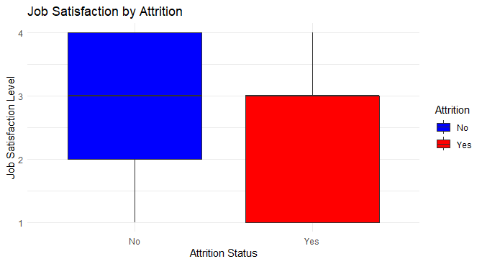
Top 3 Factors related to attrition: 1) Job Satisfaction
Employees with low job satisfaction are more likely to leave (left, red). Low job satisfaction can lead to disengagement, reduced productivity, and ultimately, a decision to leave.

Slide 7
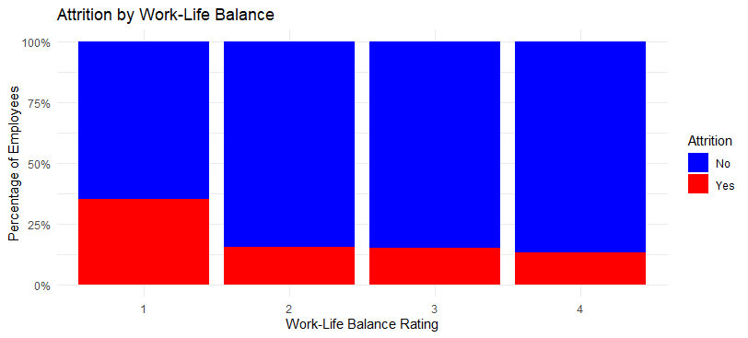
Top 3 Factors related to attrition: 2) Work-Life Balance
Those with lower work-life balance ratings show higher attrition rates; As work-life balance ratings improve, the proportion of employees who leave (red) decreases significantly. Employees with a low work-life balance rating of 1 have a much higher attrition rate compared to those with ratings of 3 or 4.

Slide 8
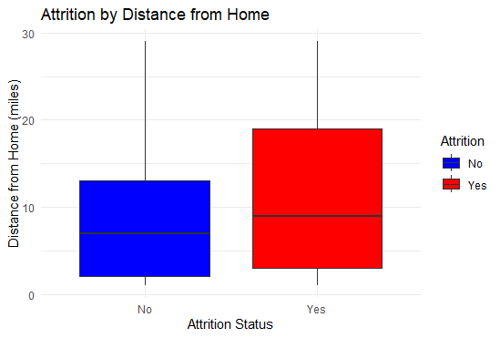
Top 3 Factors related to attrition: 3) Distance from Home
Employees living more than 20 miles away have a higher tendency to leave. Employees who left the company (in red) tend to live farther away from their workplace. The median distance for employees who left is higher than for those who stayed, showing that long commutes can increase the likelihood of attrition.

Slide 9
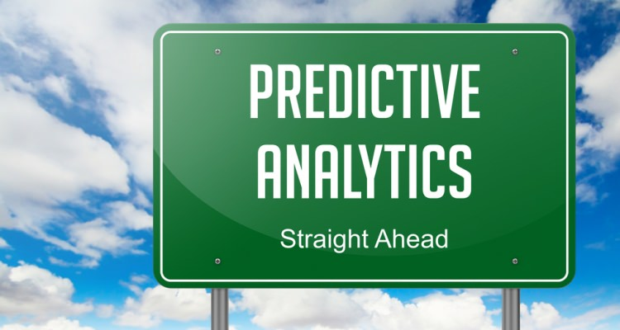
Predictive model
Model Overview:
Chosen Model: Naive Bayes Classifier
Data Split: 80% training, 20% testing
Threshold Tuning: Set a threshold of 0.6 to balance sensitivity and specificity.
Sampling: Used up-sampling to address class imbalance in the training data.

Slide 10
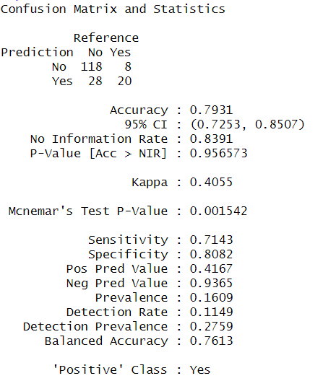
Predictive model: using Naïve Bayes
Results and Evaluation:
Accuracy: 79.31%
Sensitivity : 71.43%. The model is highly sensitive in predicting would will stay.
Specificity: 80.82%. The model is effective in likely identifying attrition cases.
Precision: 41.67%
F1 Score: 0.5245

Slide 11
Predictive model: Interpretation
This model provides a reasonably accurate way to predict attrition. It is good at capturing potential attrition cases (high sensitivity: 71.43%) and reliably identifies employees who are likely to stay (high specificity: 80.82%).

Slide 12
Recommendations
Increase Job Satisfaction:
Consider adding meaningful assignments in daily job tasks.
Enhance Work-Life Balance:
Flexible working arrangements and increasing amount of paid-time off.
Address Long Commutes:
Consider offering remote work to alleviate long travels for affected employees.

Slide 13
Thank You
Email: Vnkongolo@smu.edu

